Slide 1



Thailand
Malaysia
Vietnam

Slide 2
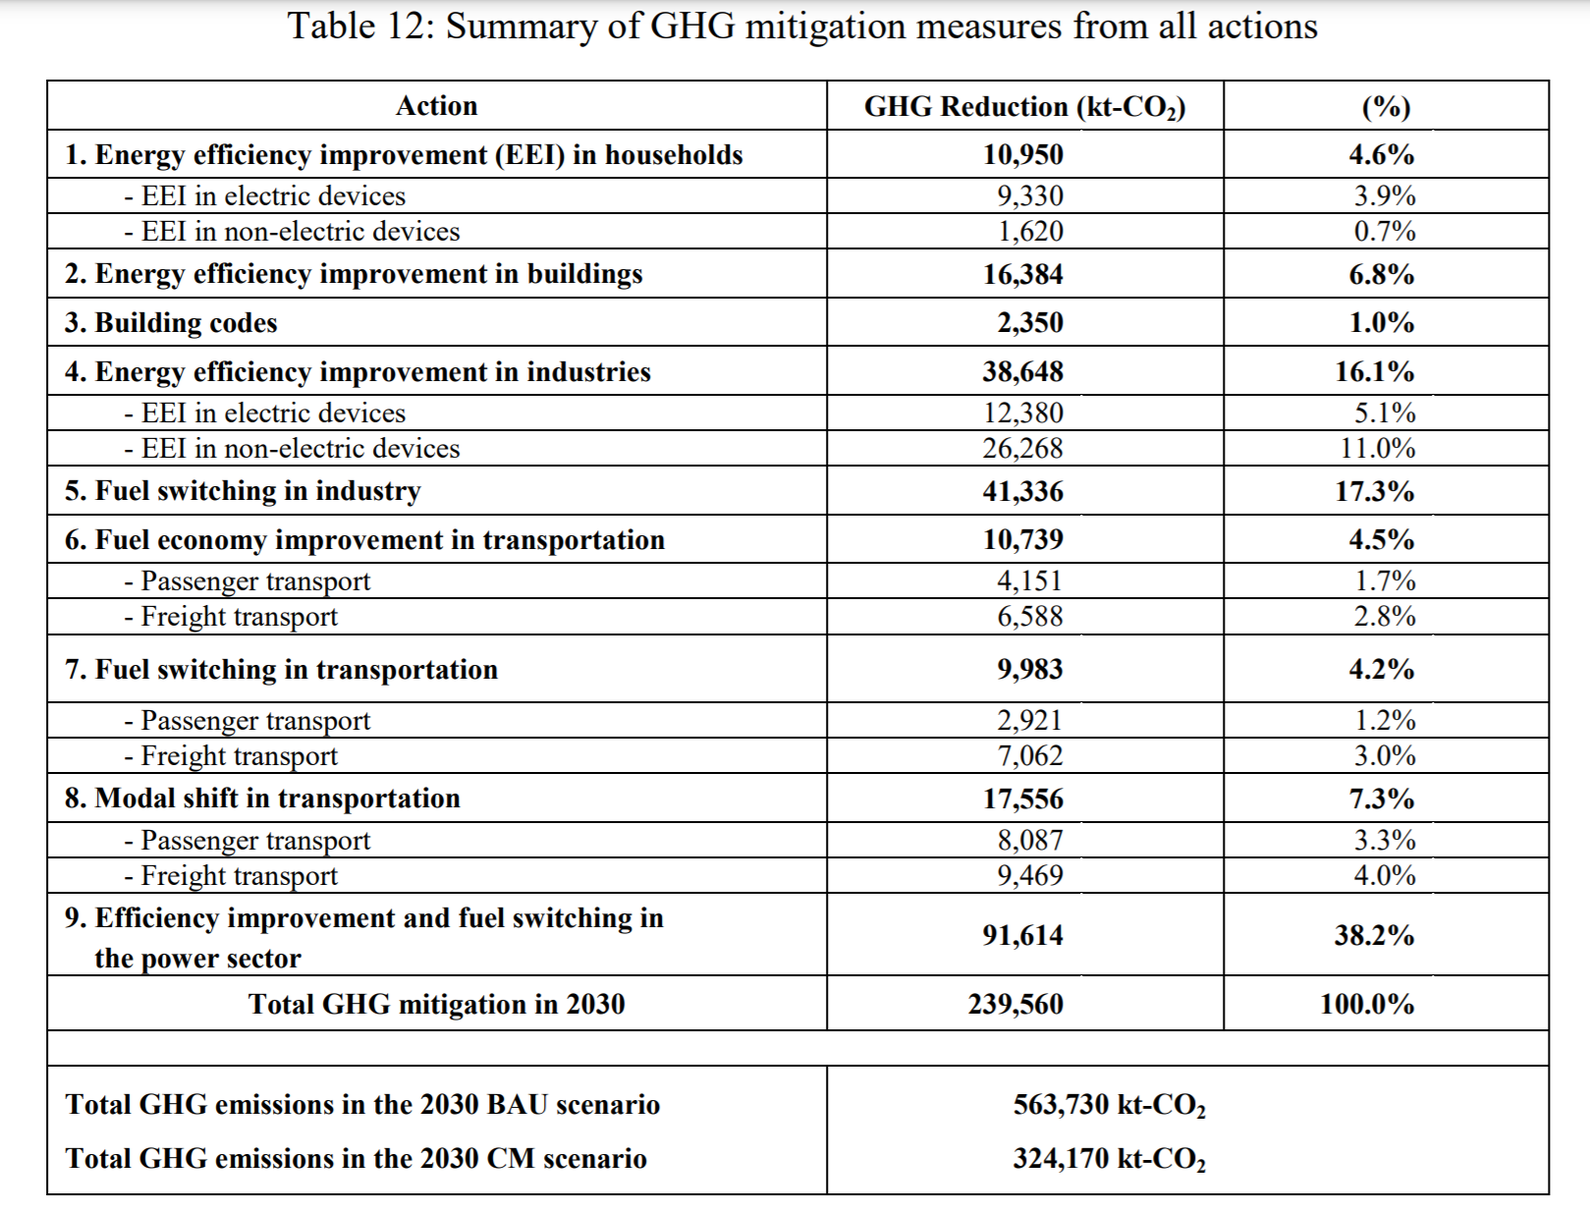
Mandatory
Extended
Smart
Mandatory
Extended
Smart
Action 1
Action 2
Action 1
Action 2
Action 1
Action 2

Slide 3
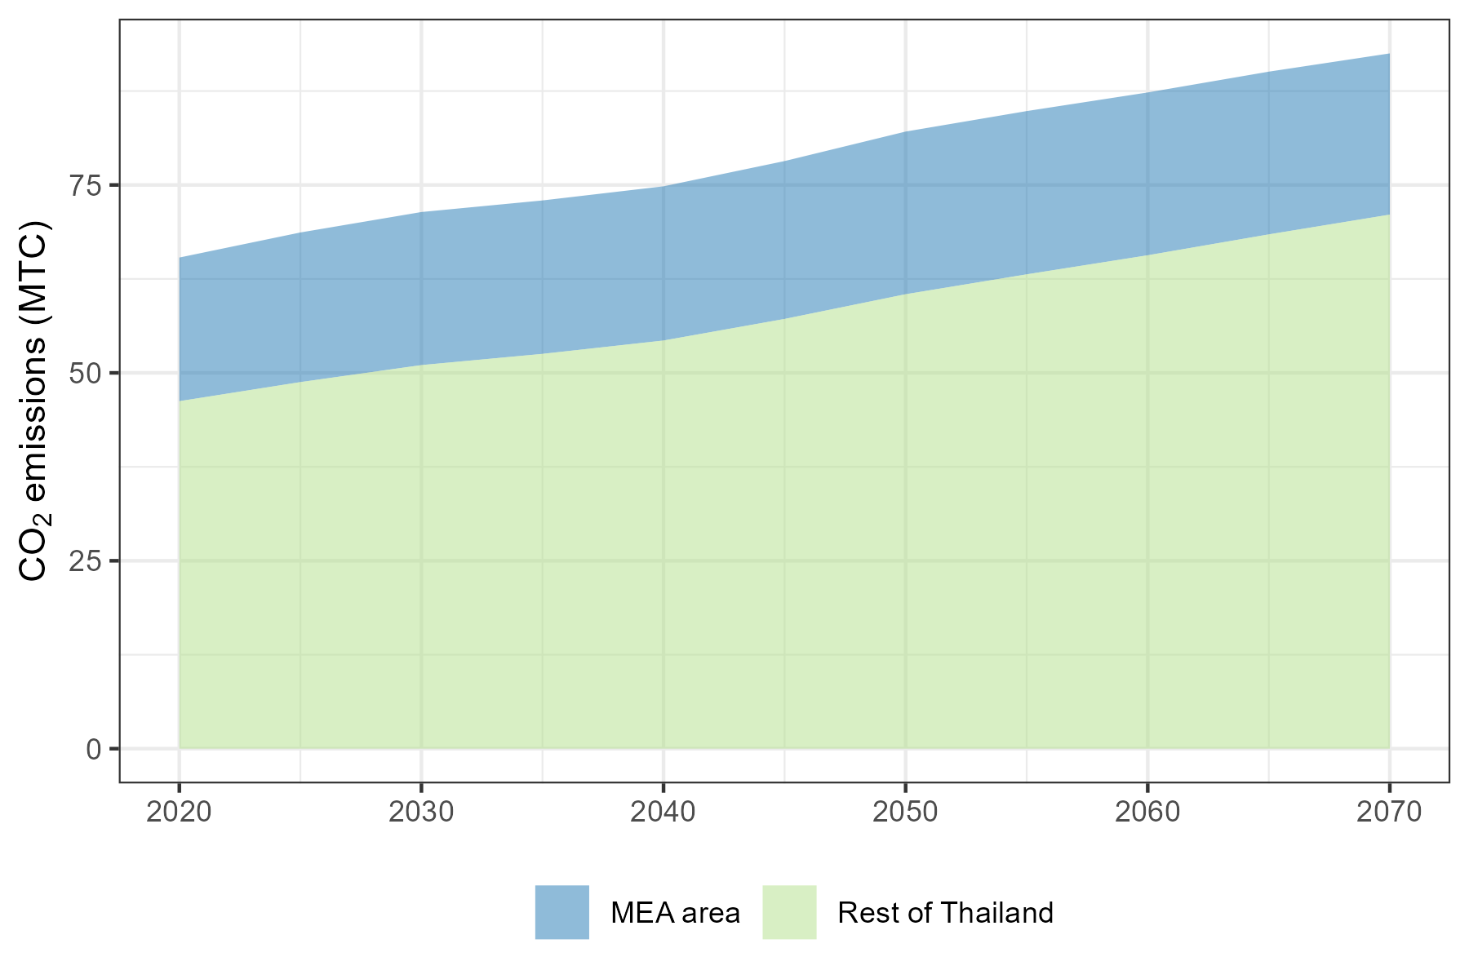
Conceptual Figure: Emissions Pathways
BAU
City-Level
National
Net-zero
Other Measures
City - Level
Rest of Country

Slide 4
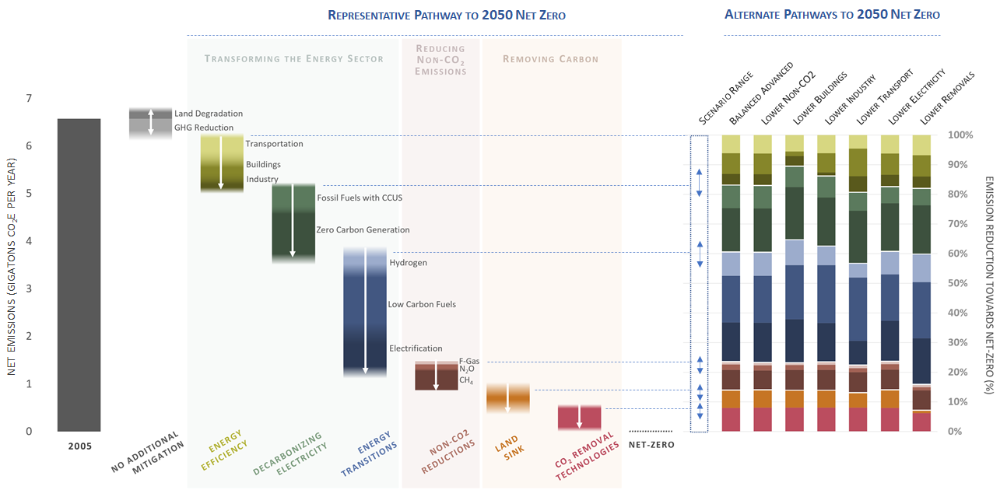

Slide 5
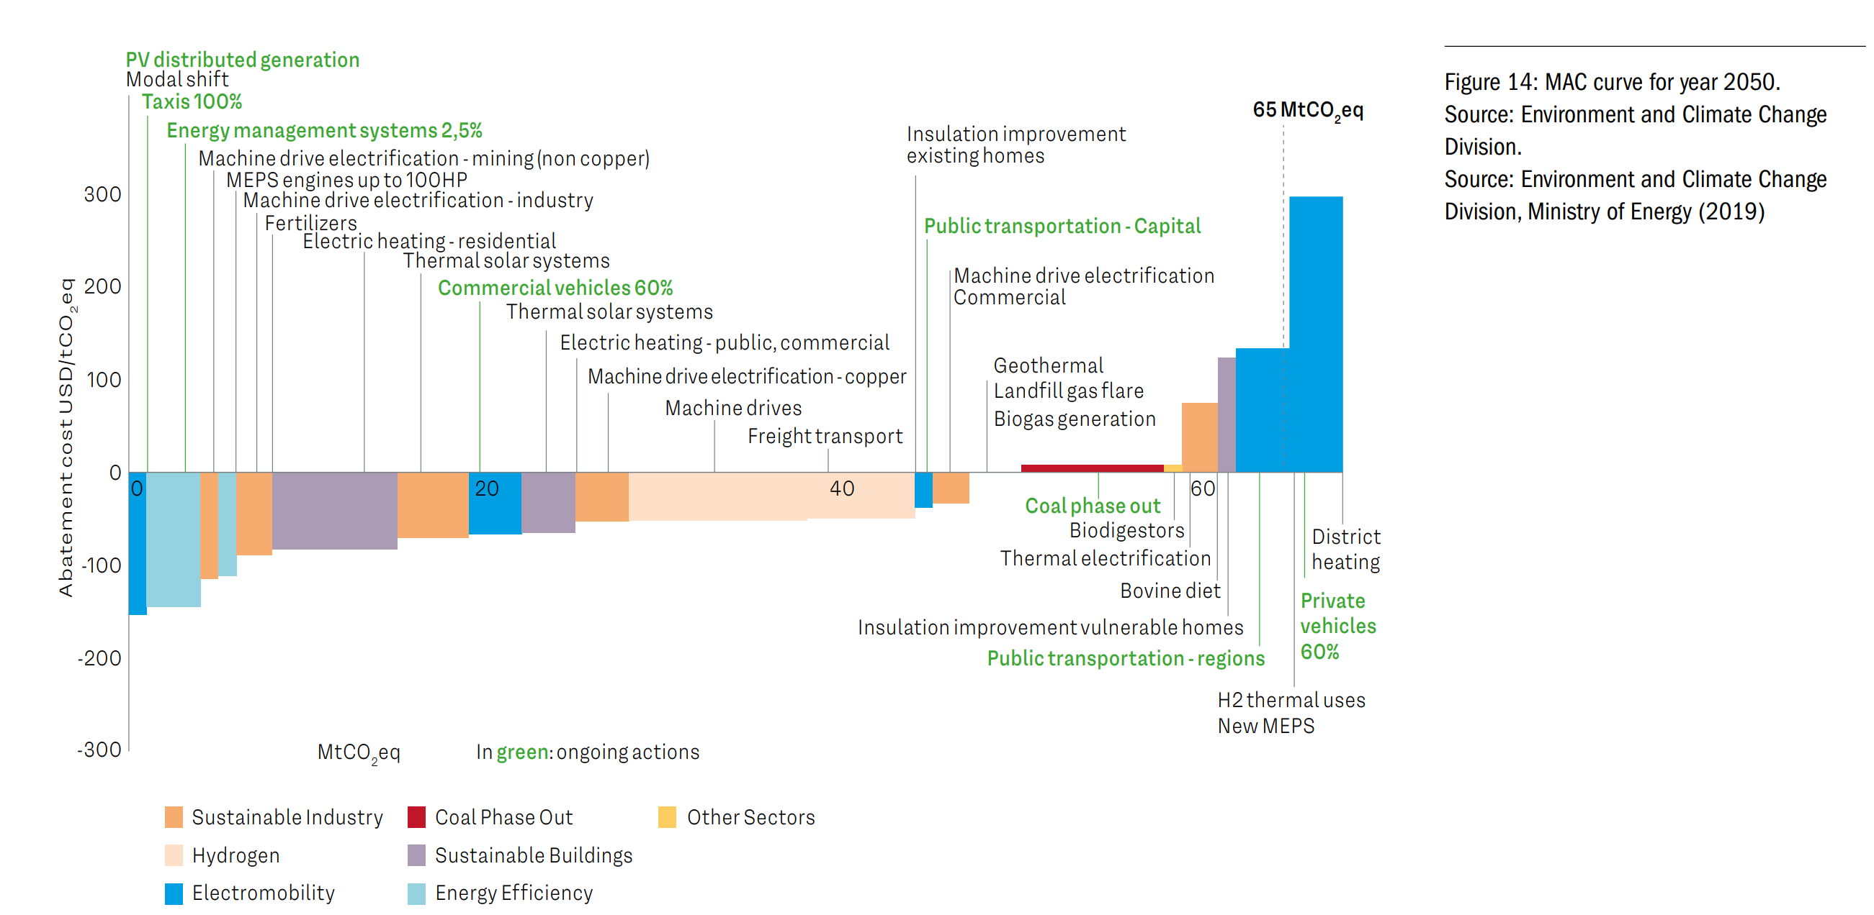

Slide 6
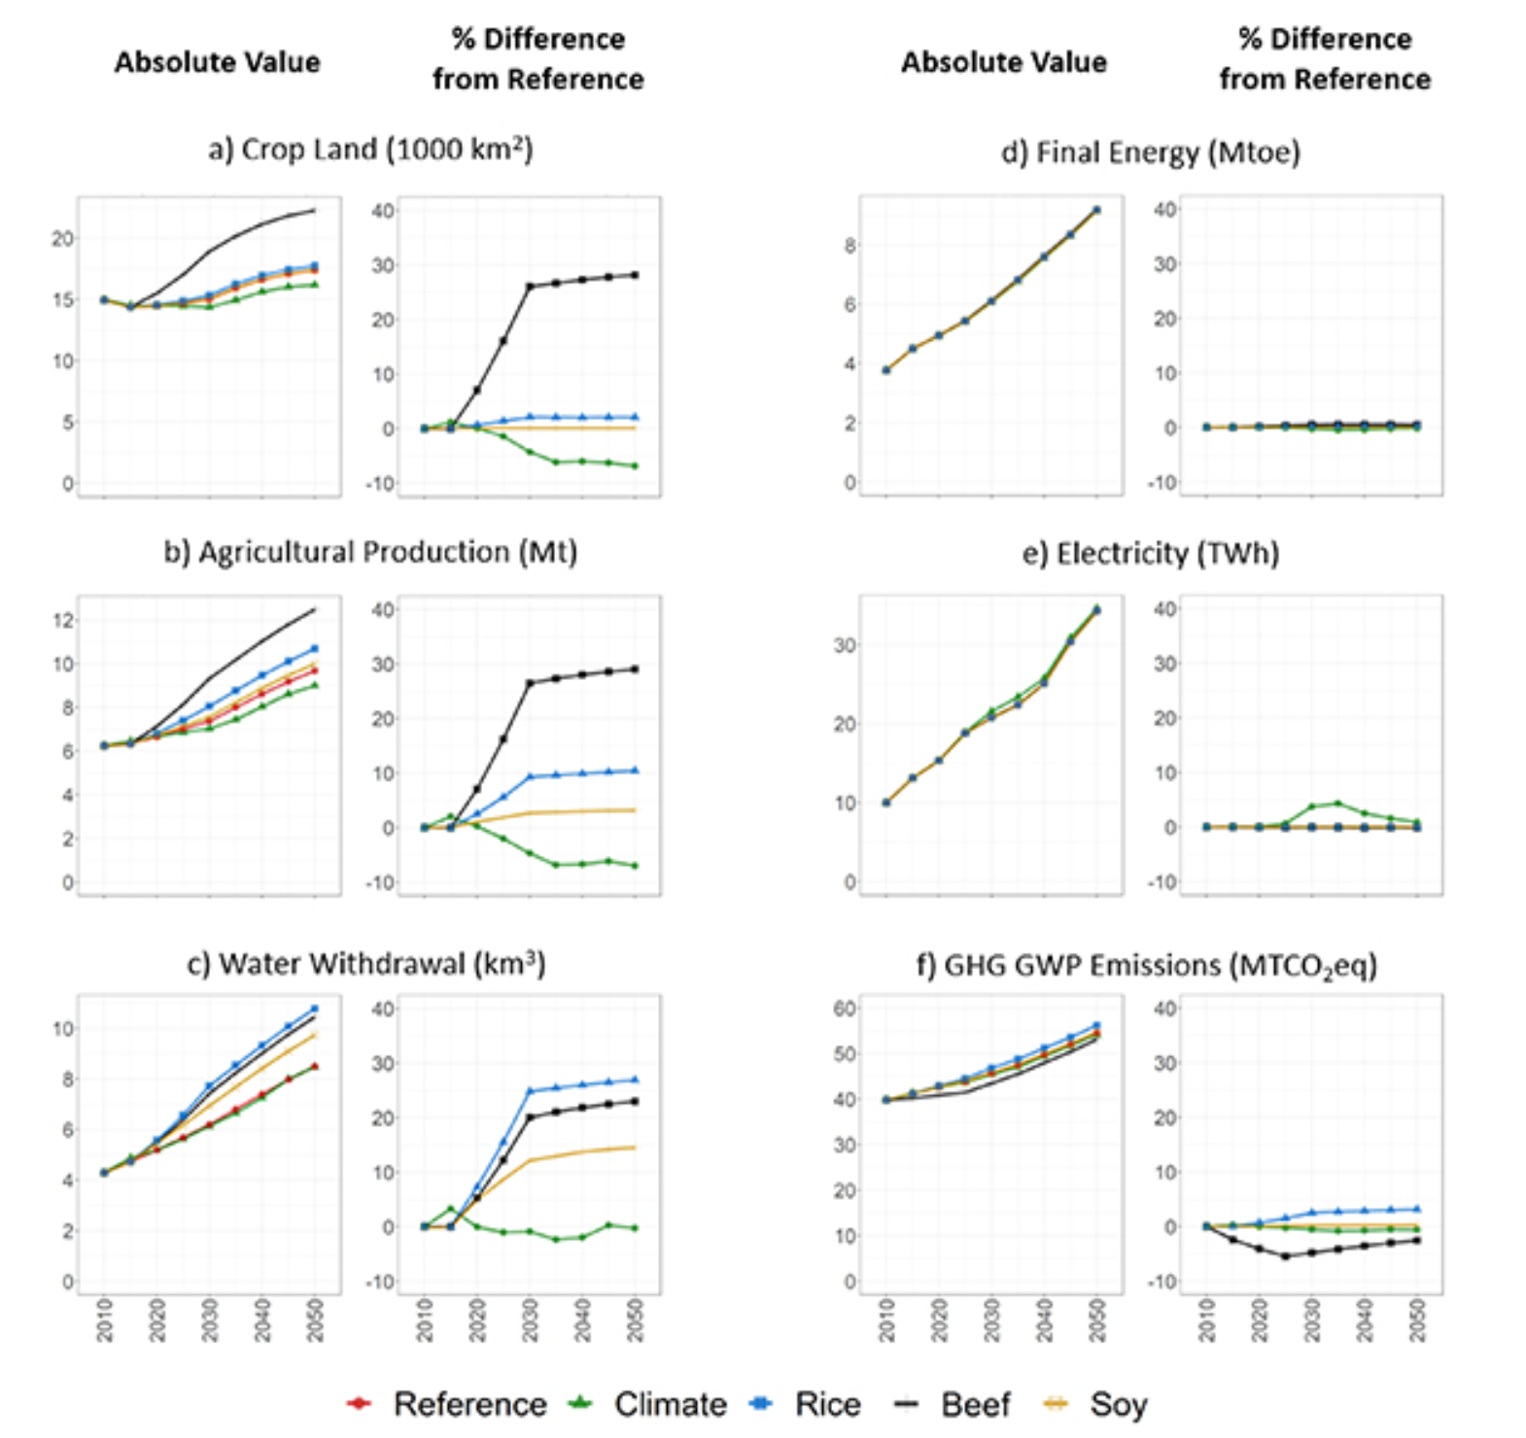

Slide 7
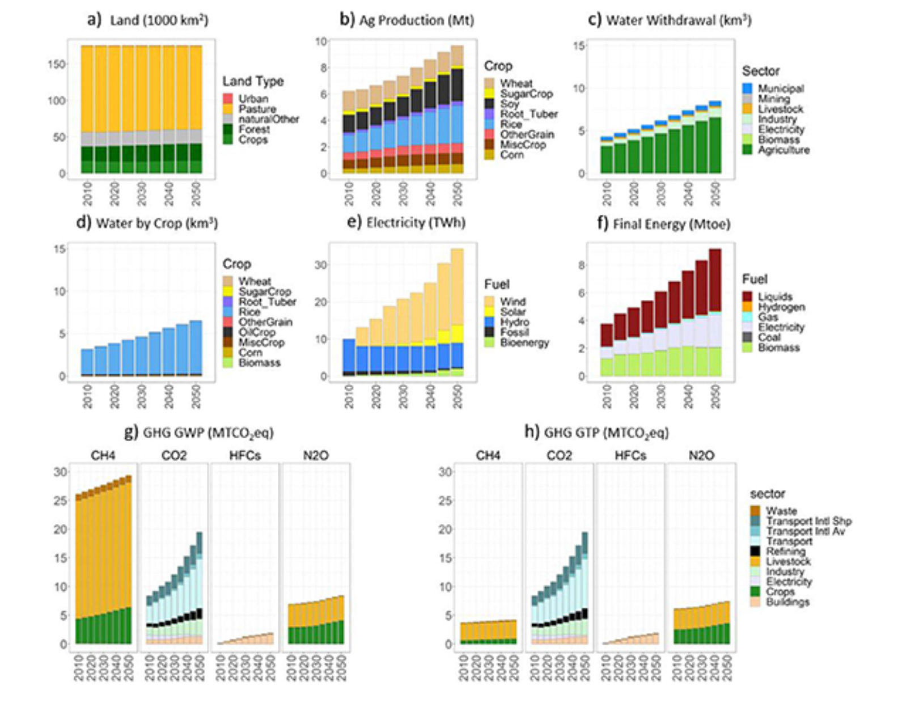

Slide 8
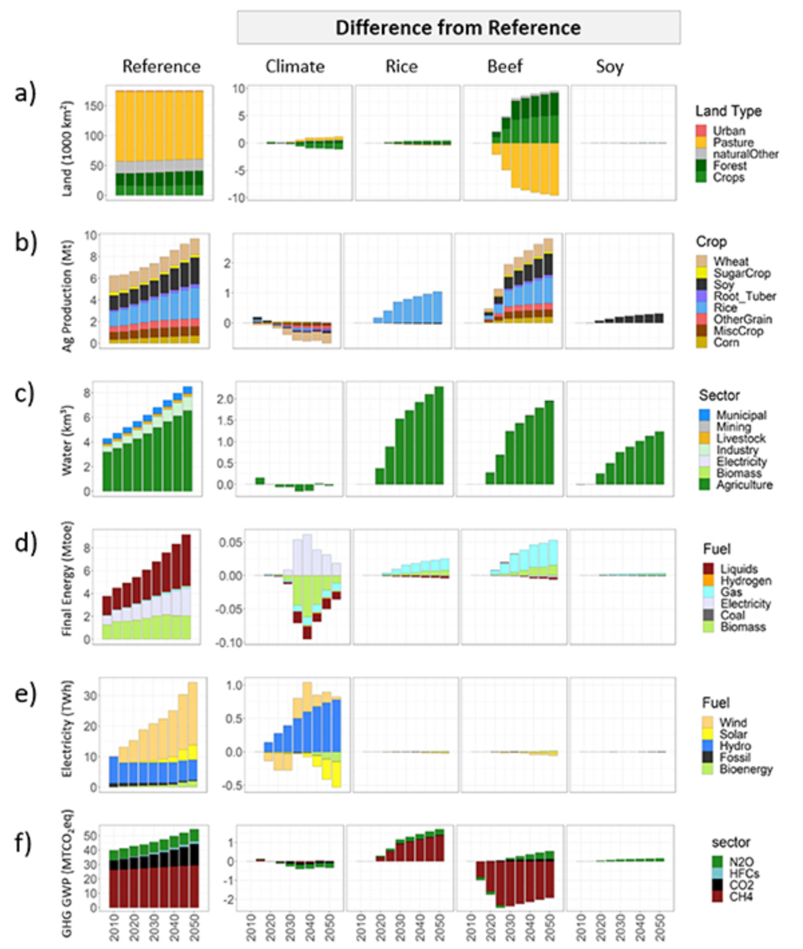

Slide 9







Slide 10


USASCP
US-ASEAN Smart Cities Partnership

Slide 11





USASCP
US-ASEAN Smart Cities Partnership
USASCP
Modeling & Analysis
Stakeholder engagement
Office of Natural Resources and Environmental Policy and Planning
Bangkok Metropolitan Authority
Electricity Generating Authority of Thailand

Slide 12
US-ASEAN Smart Cities Partnership
U.S. Department of State
USASCP
Modeling & Analysis
Stakeholder engagement
Office of Natural Resources and Environmental Policy and Planning
Bangkok Metropolitan Authority
Electricity Generating Authority of Thailand

Slide 13
Modeling & Analysis
Stakeholder engagement
Office of Natural Resources and Environmental Policy and Planning
Bangkok Metropolitan Authority
Electricity Generating Authority of Thailand
USASCP
US-ASEAN Smart Cities Partnership
USASCP

Slide 14






Smart Grid Components
National Power Development Goals
MEA Focus Areas
Green Energy
Distributed Energy Resources
Supply Reliability
Energy Security
Meet demand
Ensure stability
Economy
Low costs
High efficiency
Environment
Support RE
Efficient production & consumption
Generation
Transmission & Distribution
Monitoring & Control
Data Analytics
Consumption
Customer Engagement

Slide 15
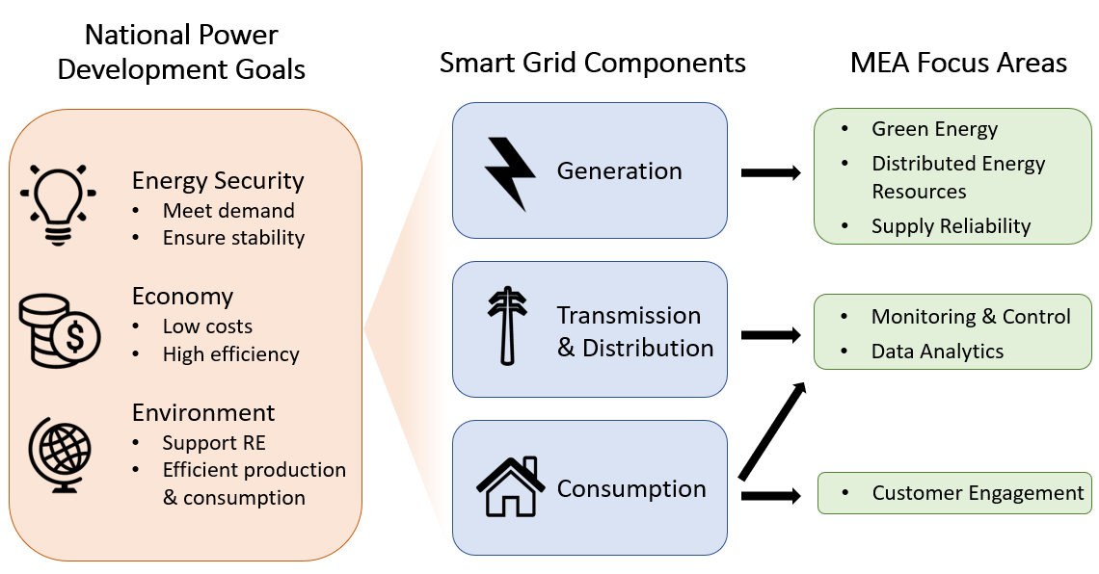

Slide 16
Thailand’s long-term low emissions development strategy

